Slide 1
Pls 2000 power & politics
Right-Wing Ideology:
Libertarianism, Nationalism & Fascism

Slide 2
RIGHT-WING Ideology: LIBERTARIANIsm, nationalism, & fascism
I. LIBERTARIANISM
II. NATIONALISM
III. FASCISM
TERMS TO KNOW
Libertarianism
Civic Nationalism
Ethnic Nationalism
Patriotism
xenophobia

Slide 3
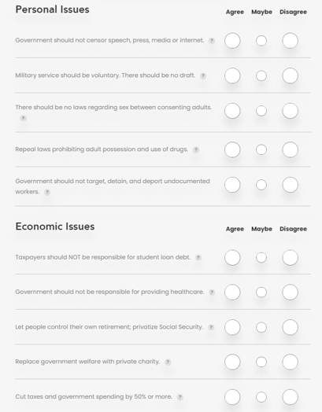
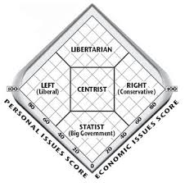
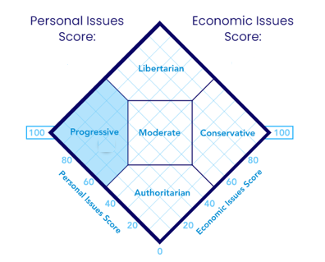

Slide 4

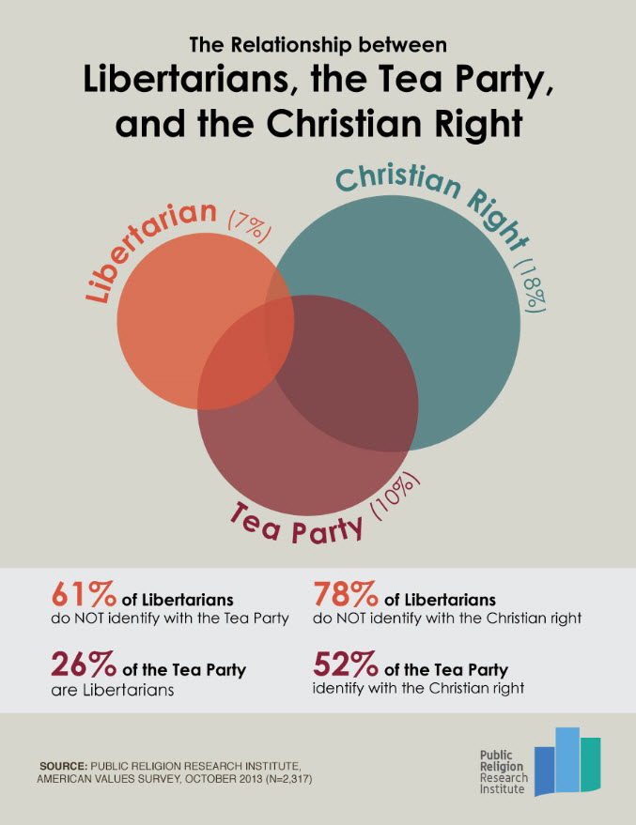
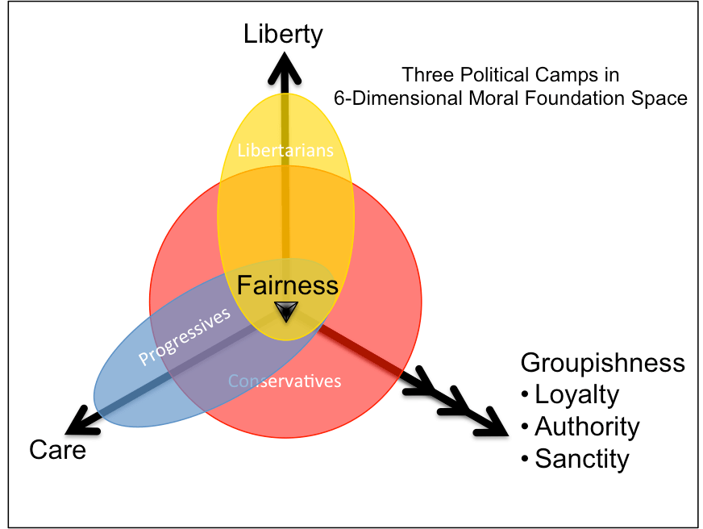
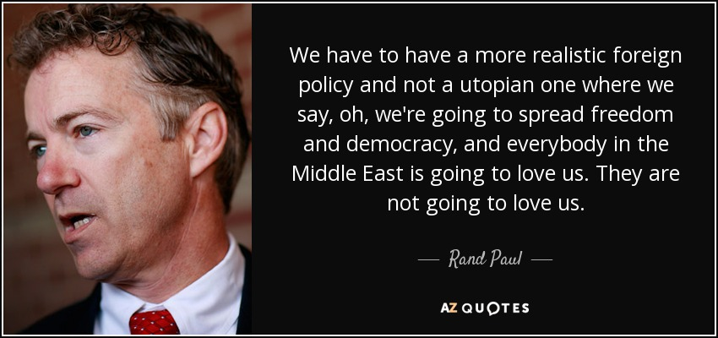
I. libertarianism
Conservative or Liberal? Strongly value individualism and individual freedom
“Each agent has a right to maximum equal empirical negative liberty”
“Collectivism is the tribal premise of primordial savages who, unable to conceive of individual rights, believed that the tribe …owns the lives of its members and may sacrifice them whenever it pleases
Strong distrust of state and power: minimal role to provides strong protections for individual freedom.
People can be coerced to only refrain from violating the rights of others; they “cannot be coerced to serve the overall good of society, or even their own personal good.”
Defense-dominant foreign policy: less militarism but also less international aid and assistance
https://plato.stanford.edu/entries/libertarianism/
Notes:
Basically, want government to do nothing, they don’t want to sacrifice any freedom to the group.

Slide 5
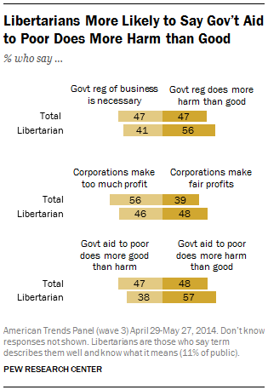
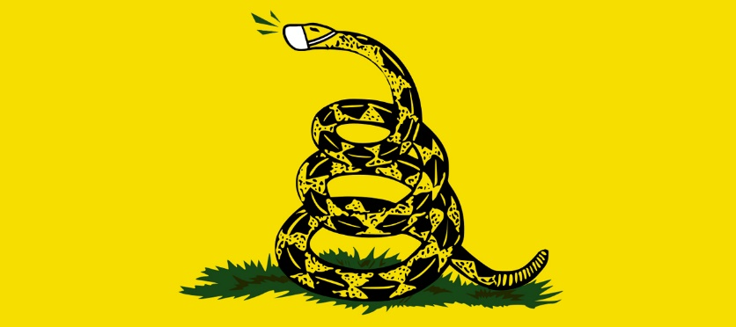
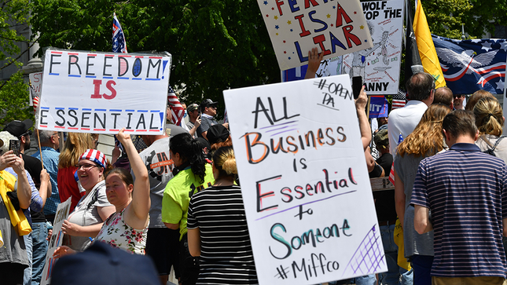
I. libertarianism
“What happens when you take Ayn Rand seriously”
“Unfettered self-interest” and self-reliance are supreme goods
altruism is destructive and unnatural
prosocial tendencies are “diseases” imposed on us by society, insidious lies that cause us to betray biological reality.
“What Libertarians Would Do in Response to a Pandemic”
Keep government open, oppose lockdowns, and stress personal responsibility
https://www.pewresearch.org/fact-tank/2014/08/25/in-search-of-libertarians/
https://theweek.com/articles/901738/what-libertarians-response-coronavirus

Slide 6
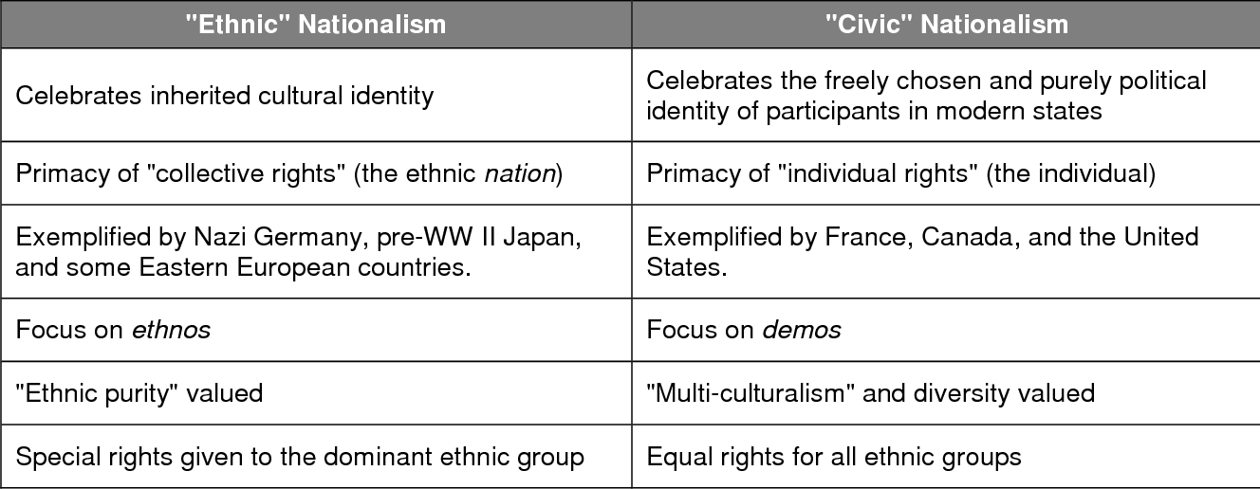
II. Nationalism (p.132)
Identity and belonging based on a common language, culture, ethnicity...
Nation: “a group of people that conceives of itself as constituting a unique community with a particular identity … an imagined community where total strangers…acknowledge each other as belonging to the same group”
…and that such groups ought to be able to govern themselves
“Regain lost national autonomy”; nostalgia for an imagined past”
Civic nationalism: embraces all people who are loyal to the state, regardless of their origins (Inclusive)
Ethnic nationalism: refers to a shared inheritance based on culture, language, religion etc. (Exclusive)
https://www.frontiersin.org/articles/10.3389/fpsyg.2018.01402/full
https://onlinelibrary.wiley.com/doi/10.1111/nana.12345

Slide 7
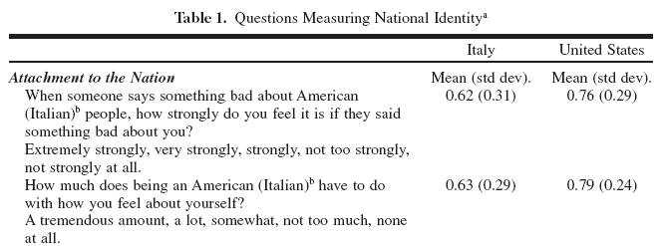
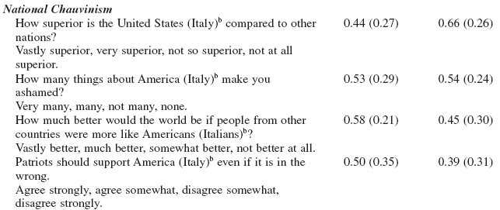
II. NATIONALISM
Patriotism: national attachment & positive feelings about one's own country.
"I love my country"
"I am proud to be an American“
“I am emotionally attached to my country and emotionally affected by its actions.“
Nationalism (national chauvinism): feelings of national superiority over others, and need for national power and dominance.
"In view of America's moral superiority…we should have the biggest say in… UN policy”
"Other countries should try to make their governments as much like ours as possible.”
https://www.economist.com/blogs/graphicdetail/2017/02/daily-chart-0?fsrc=scn/fb/te/bl/ed/whatdefinesanationsidentitydailychart
http://www.psych.lse.ac.uk/psr/PSR2011/20_02.pdf
Notes:
Patriotism: I like my country (pride in country)
Nationalism: my country is so good that others should also be like it (feelings of country superiority)

Slide 8
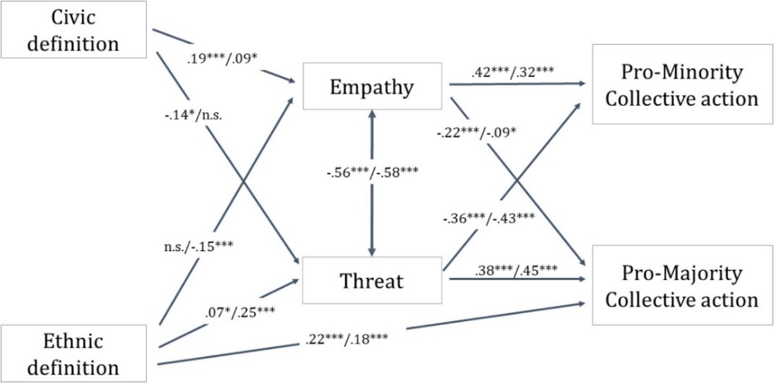

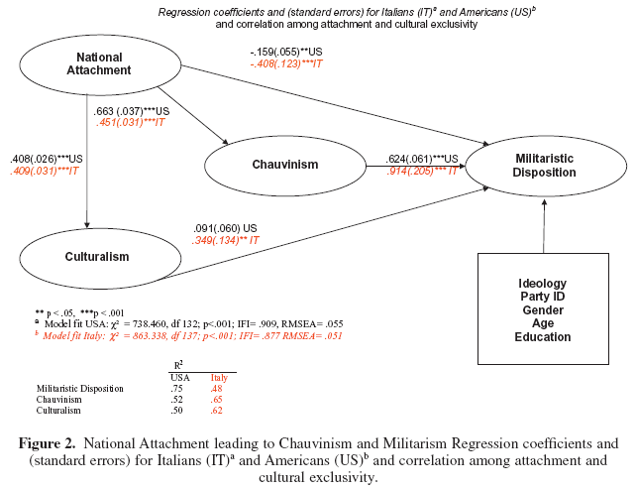
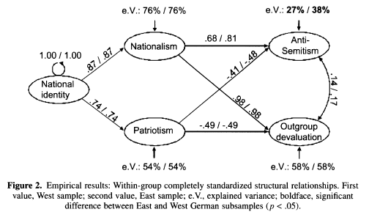
NATIONALISM’S Effects

Slide 9
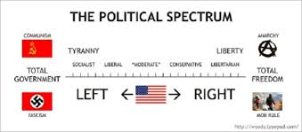

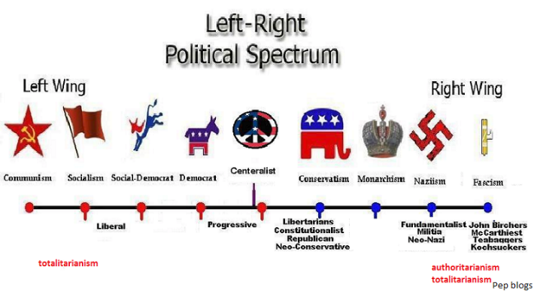
iii. fascism
NOT Left-wing
“National Socialism” was Hitler’s use of state centric welfare but for the “Nation” not classes, globalists, etc.
Fascism was a response to liberalism and socialism: anti-enlightenment (P.133-34), anti-individualist, anti-rationalist
Far-right ideology
Conservative: loyalty, authority, sanctity (Symbolism and Cult of Personality Figure)
Collective order and submission of individual liberty to the state and nation
“Oppositional” and Supremacist
Nationalist (p. 131-132): Group over individual (stronger united together)
Militarist: aggressive abroad and against “threats” at home (Brownshirt vigilantes, etc)
Racial superiority & xenophobia (fear, hostility and scapegoating toward foreign or different/minority races, ethnicities, religion

